Slide 1

Earliest castles were not very comfortable places in which to live. They were built primarily as the lord’s headquarters and provided shelters for the lord and his armies. In case of attack, they also provided a place for the safety of nearby villagers. As it became more common for the lord’s families and servants to occupy these castles, more and more buildings were added. Castles became worlds unto themselves. There were mills, bakeries, stables, smithies, mews for the hawks and more.

Slide 2
Schloss Neuschwanstein
Schloss Ribbesbüttel
Gifhorn See Schloss
Schloss Acarden Braunschweig
Schloss Charlottenburg
Schloss Weinegaröde
Schloss Bückerborg
Burg Hohenzollern
Prague Castle
Belfast castle
Dunluce Castle
Carrickfergus Castle
Sketrick Castle
Schloss Hohenschwangau

Slide 3
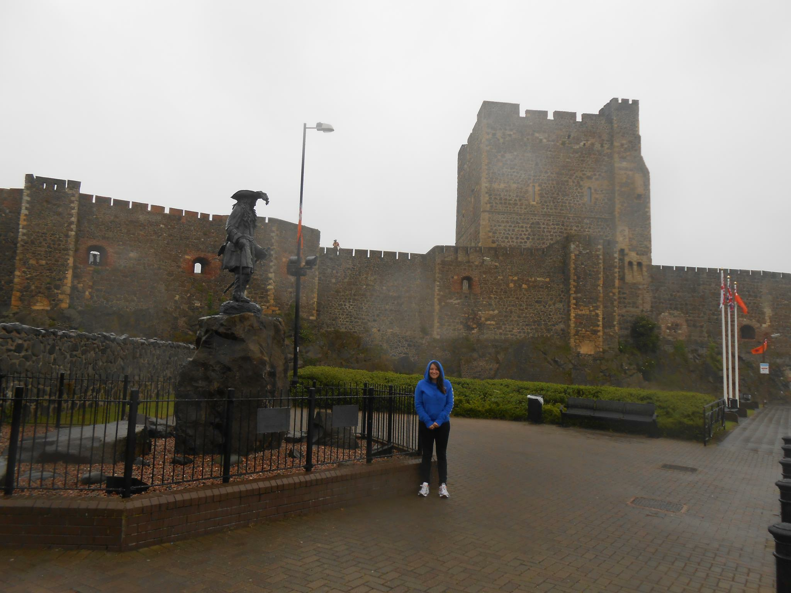
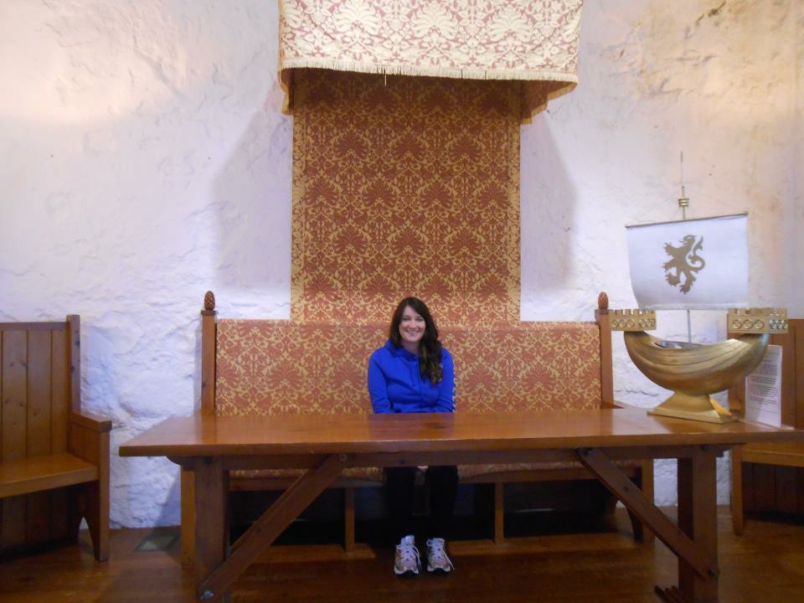
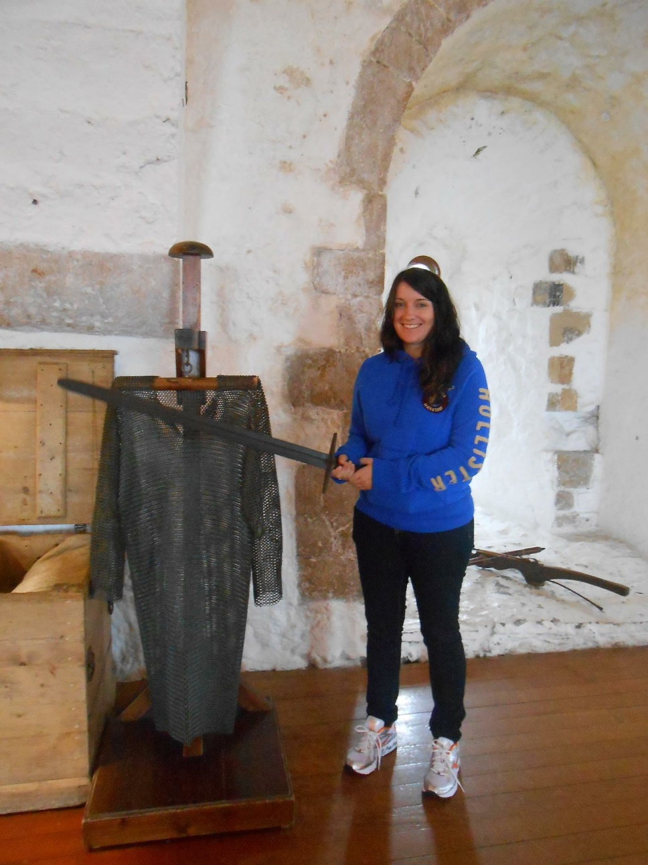

Slide 4
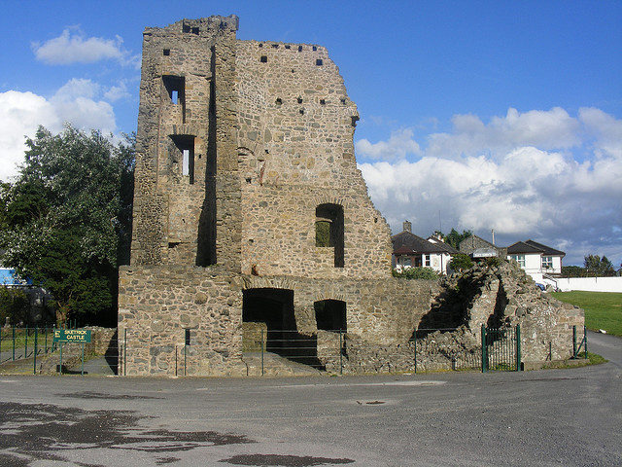
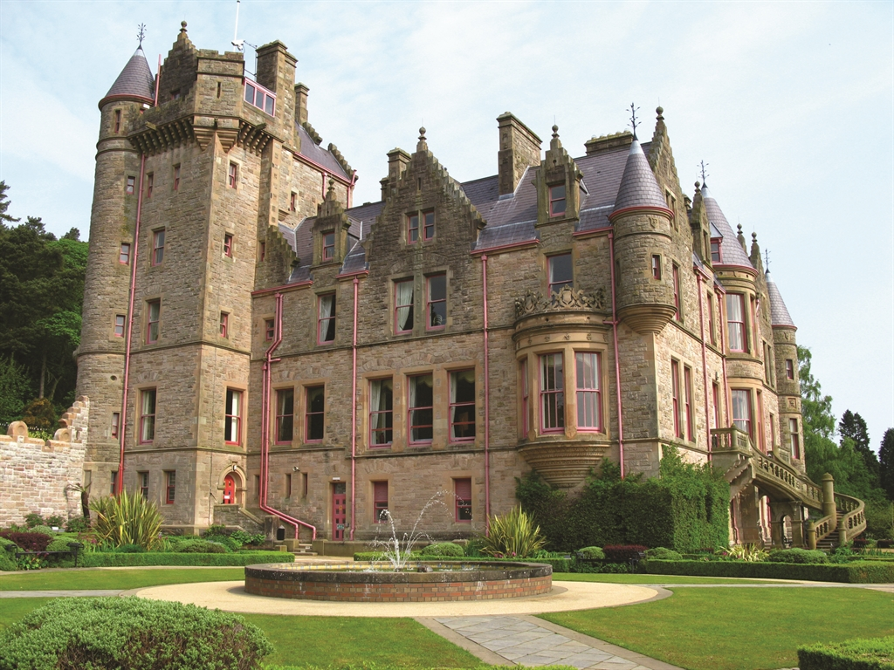
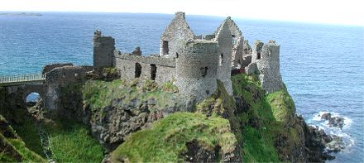

Slide 5
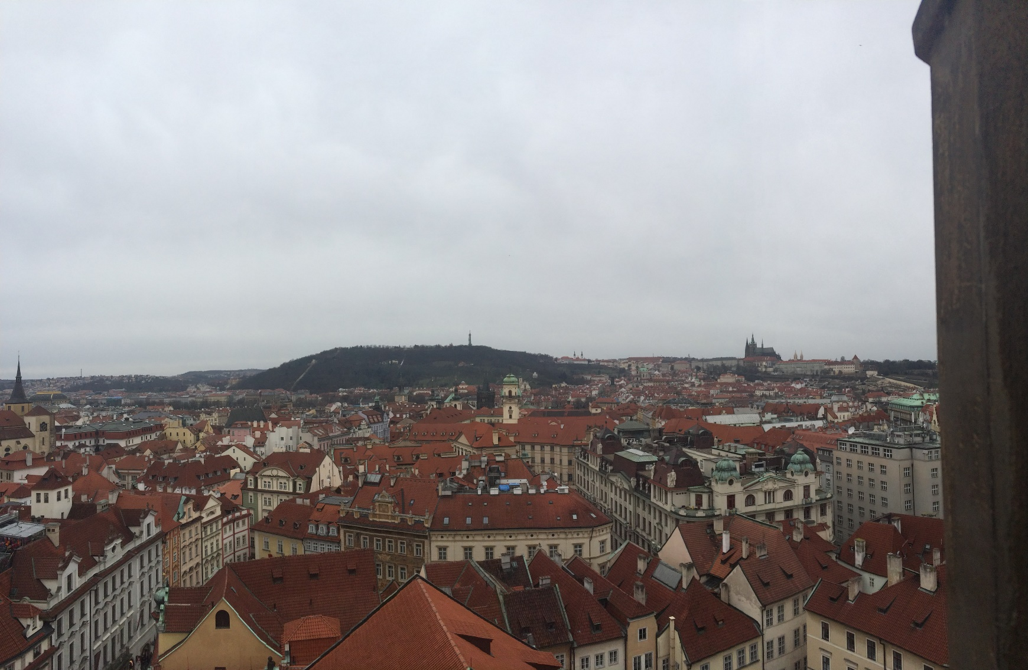
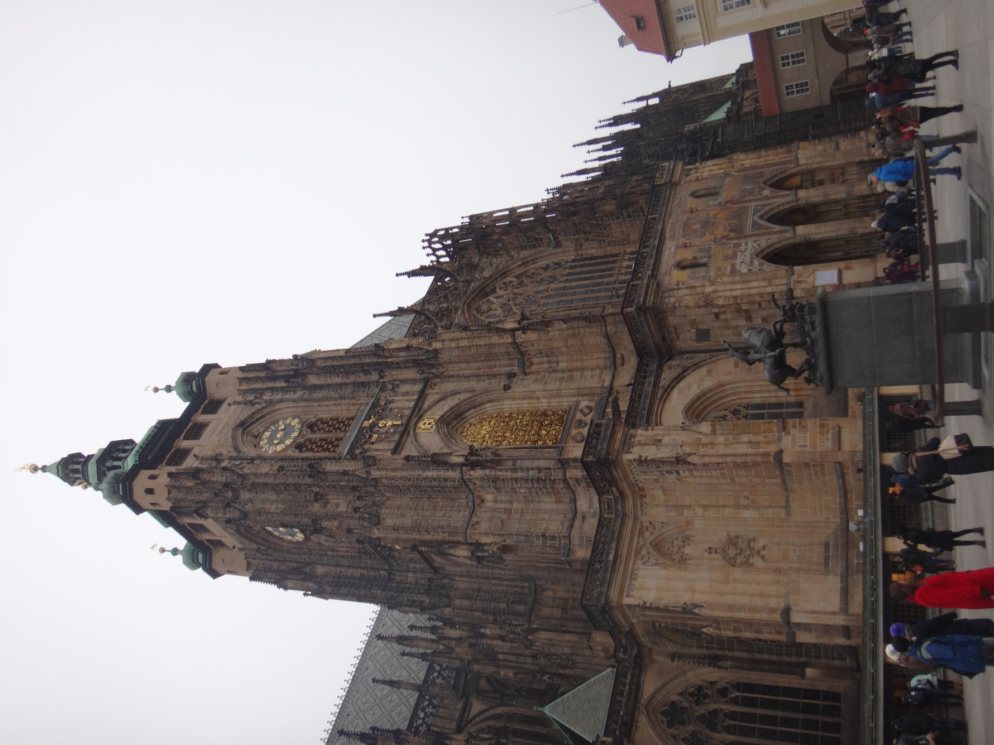
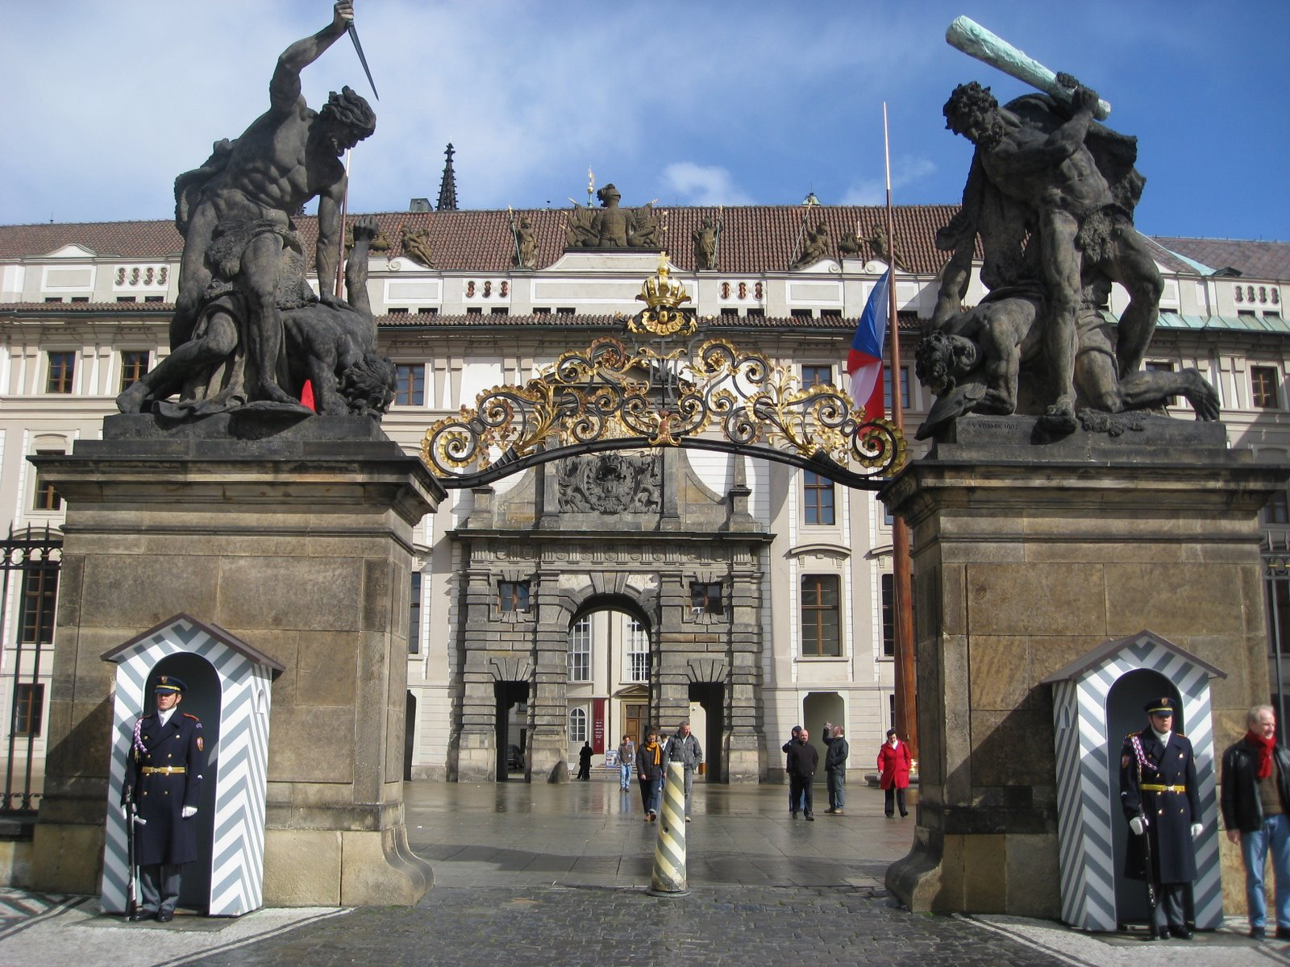

Slide 6

Before the Norman Conquest in 1066, there were only about half a dozen castles in England. When William the Duke of Normandy became the king, he immediately had dozens of motte-and-bailey castles built. The motte was the mound of earth on which the towers – usually wooden were perched. The bailey was the enclosed courtyard at the foot of the mound. Both the motte and the bailey were palisaded, or surrounded by a high, protective fence of stakes. Around the motte was a ditch. To get into the castle, you had to cross a bridge over the ditch and climb two ladders; one to get to the top of the mound and another to enter the house.

Slide 7
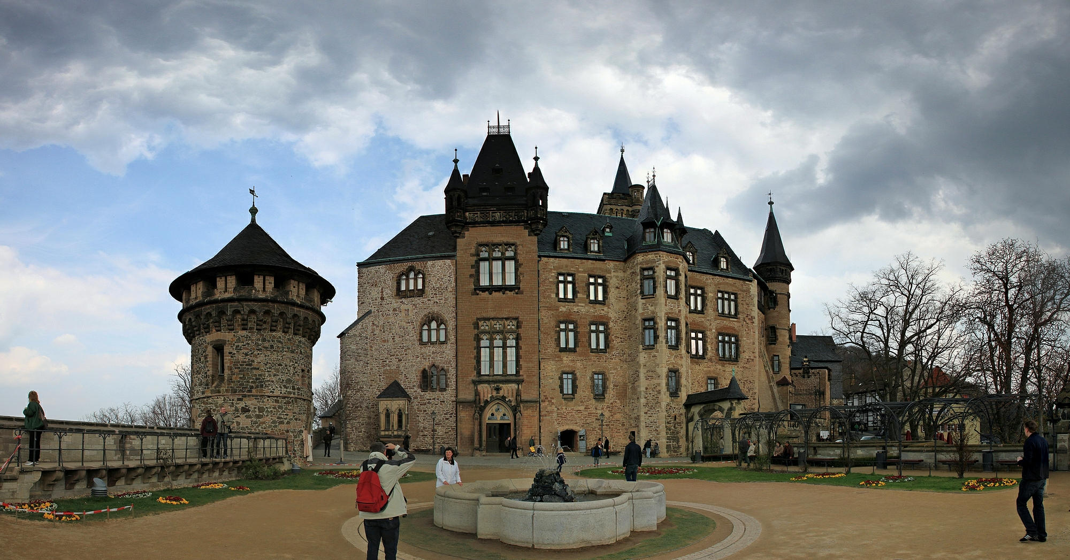
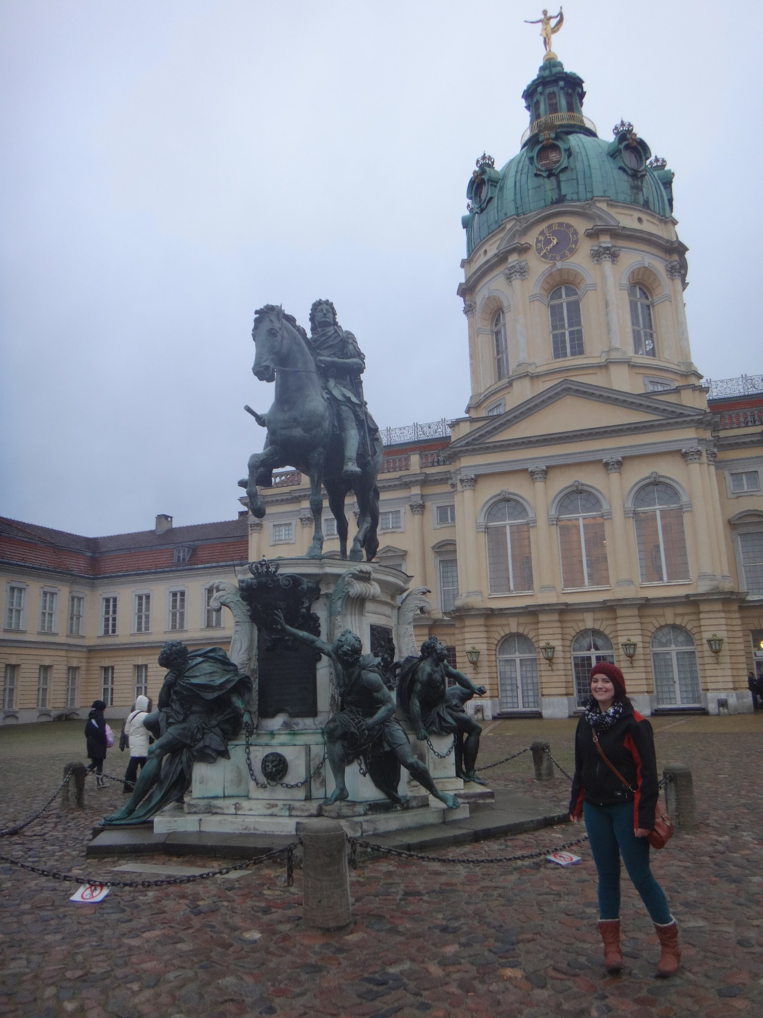
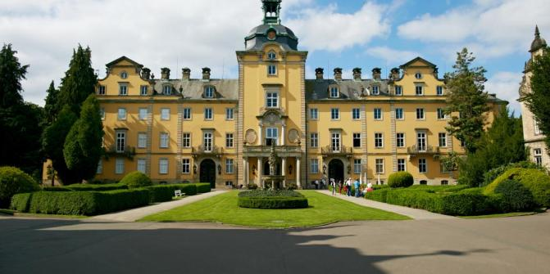

Slide 8
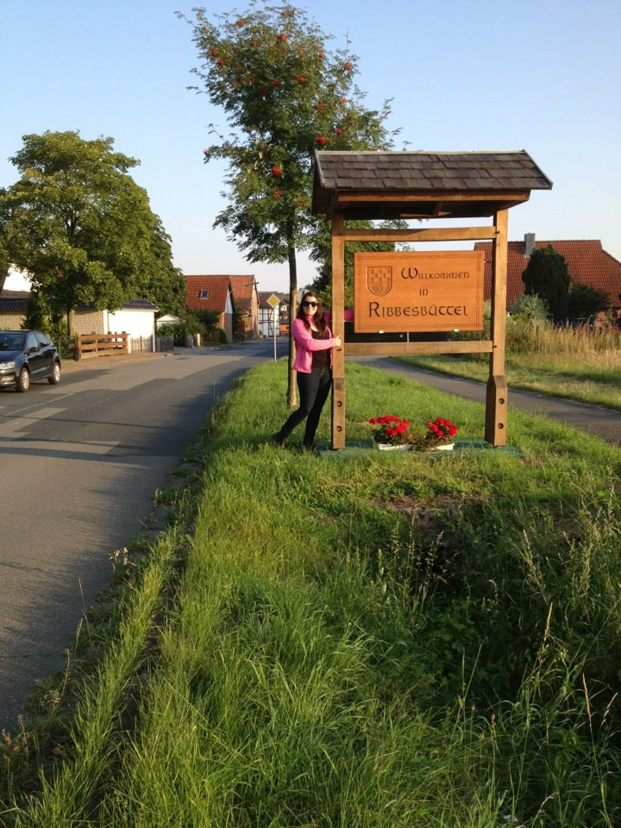
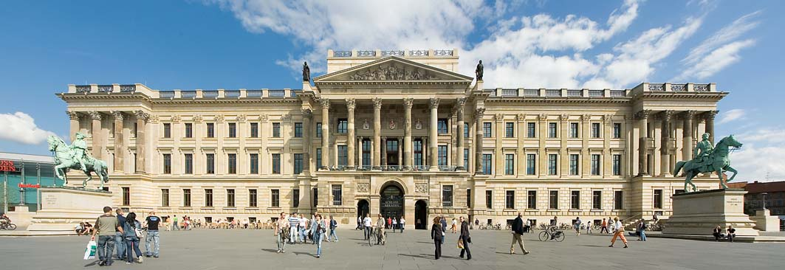
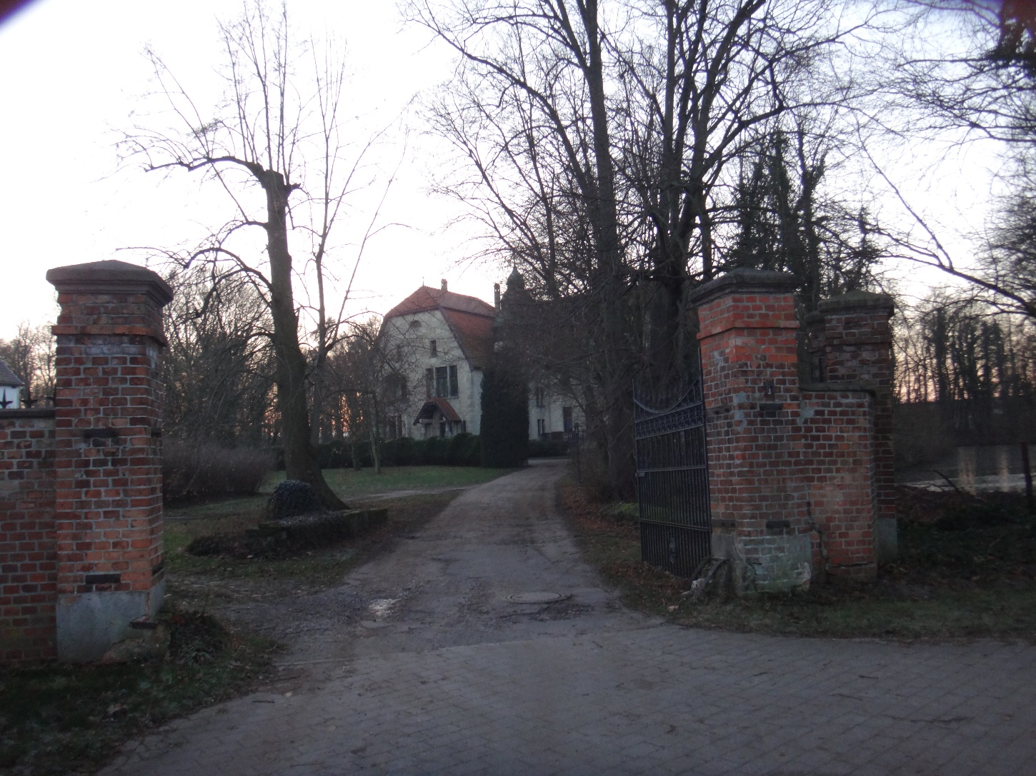
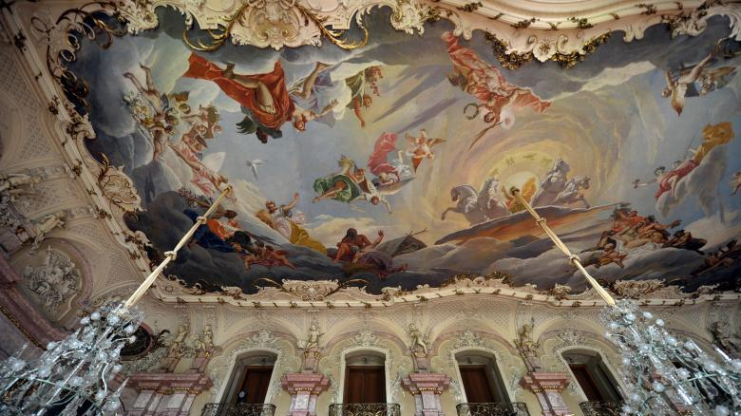

Slide 9
By the beginning of the twelfth century there were over 500 castles in England! Most were still timber, but over the course of the century many were converted to stone as new techniques in engineering were discovered. A great deal of what they learned resulted from their contact with Arabs.
By the end of the thirteenth century castle building achieved its greatest development. From about 1280-1320 the most powerful castles ever built were built in Great Britain, especially Wales.

Slide 10
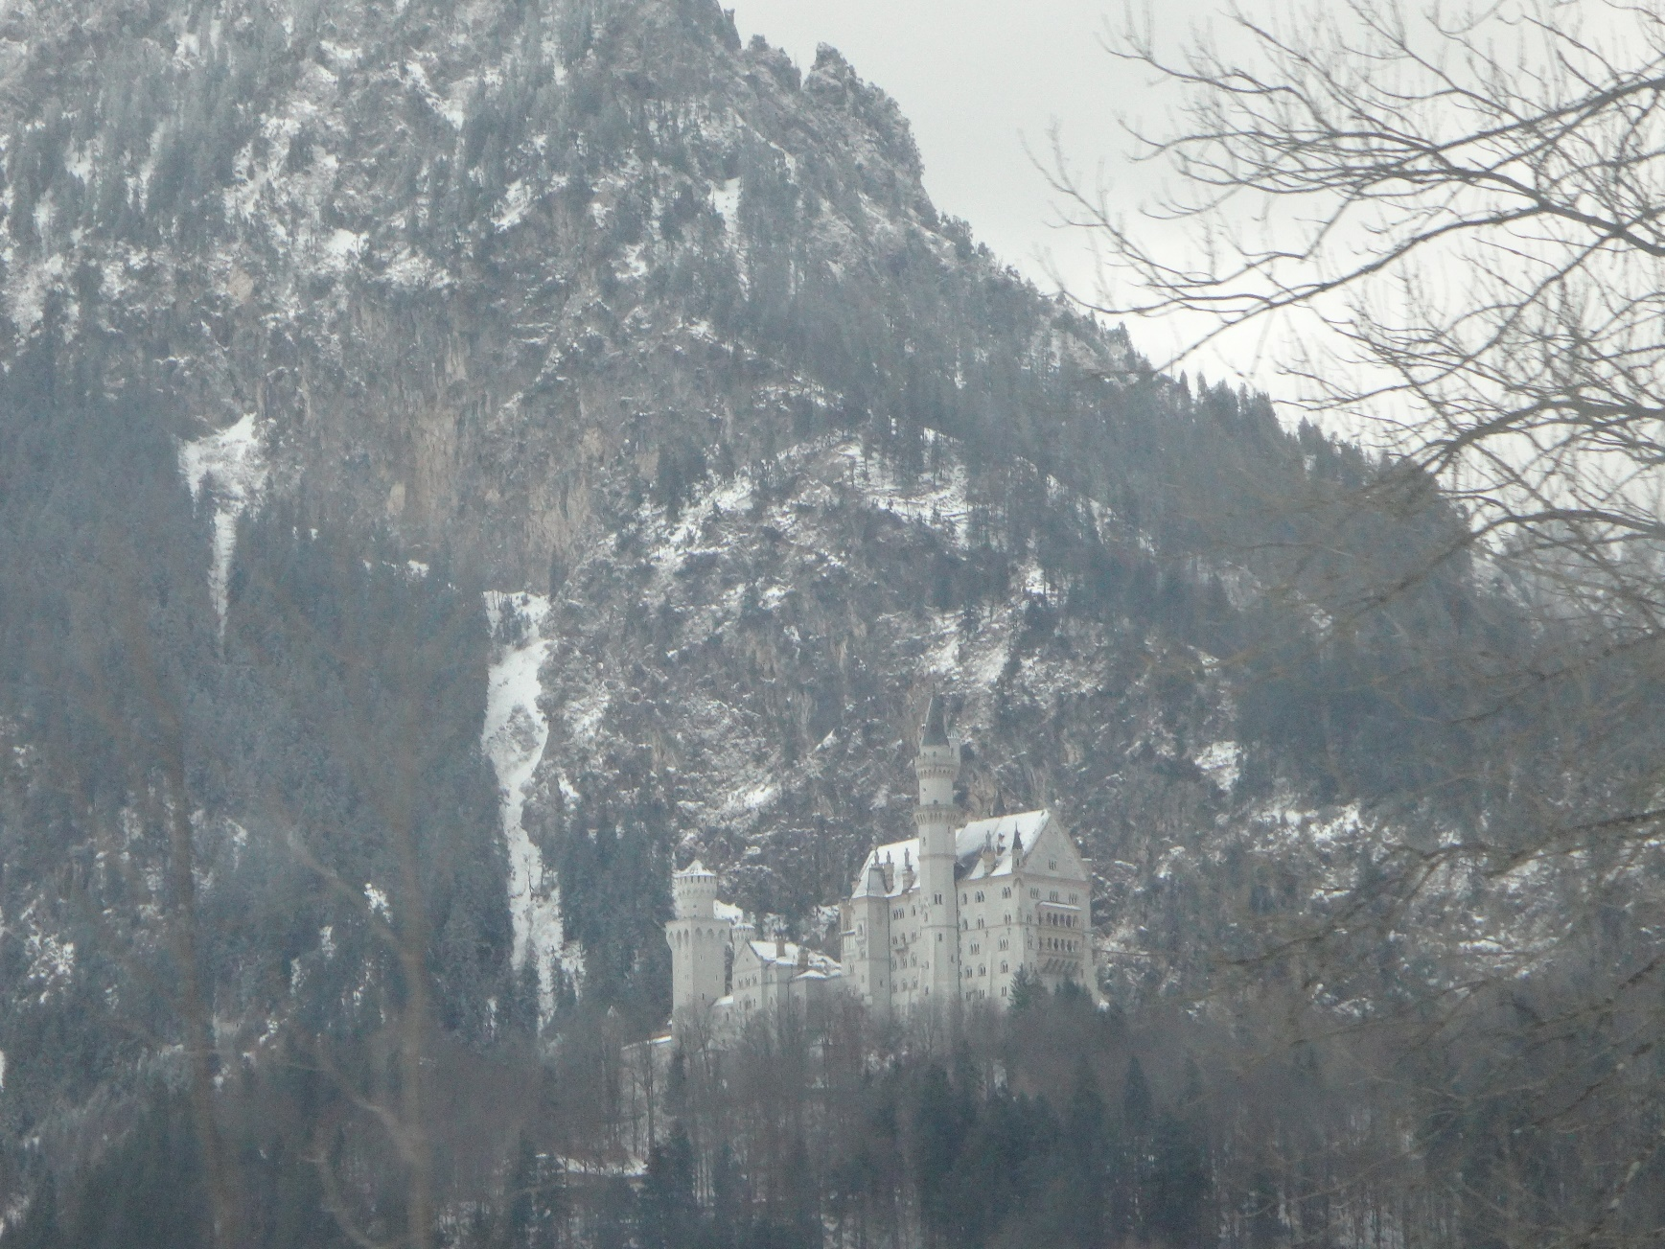
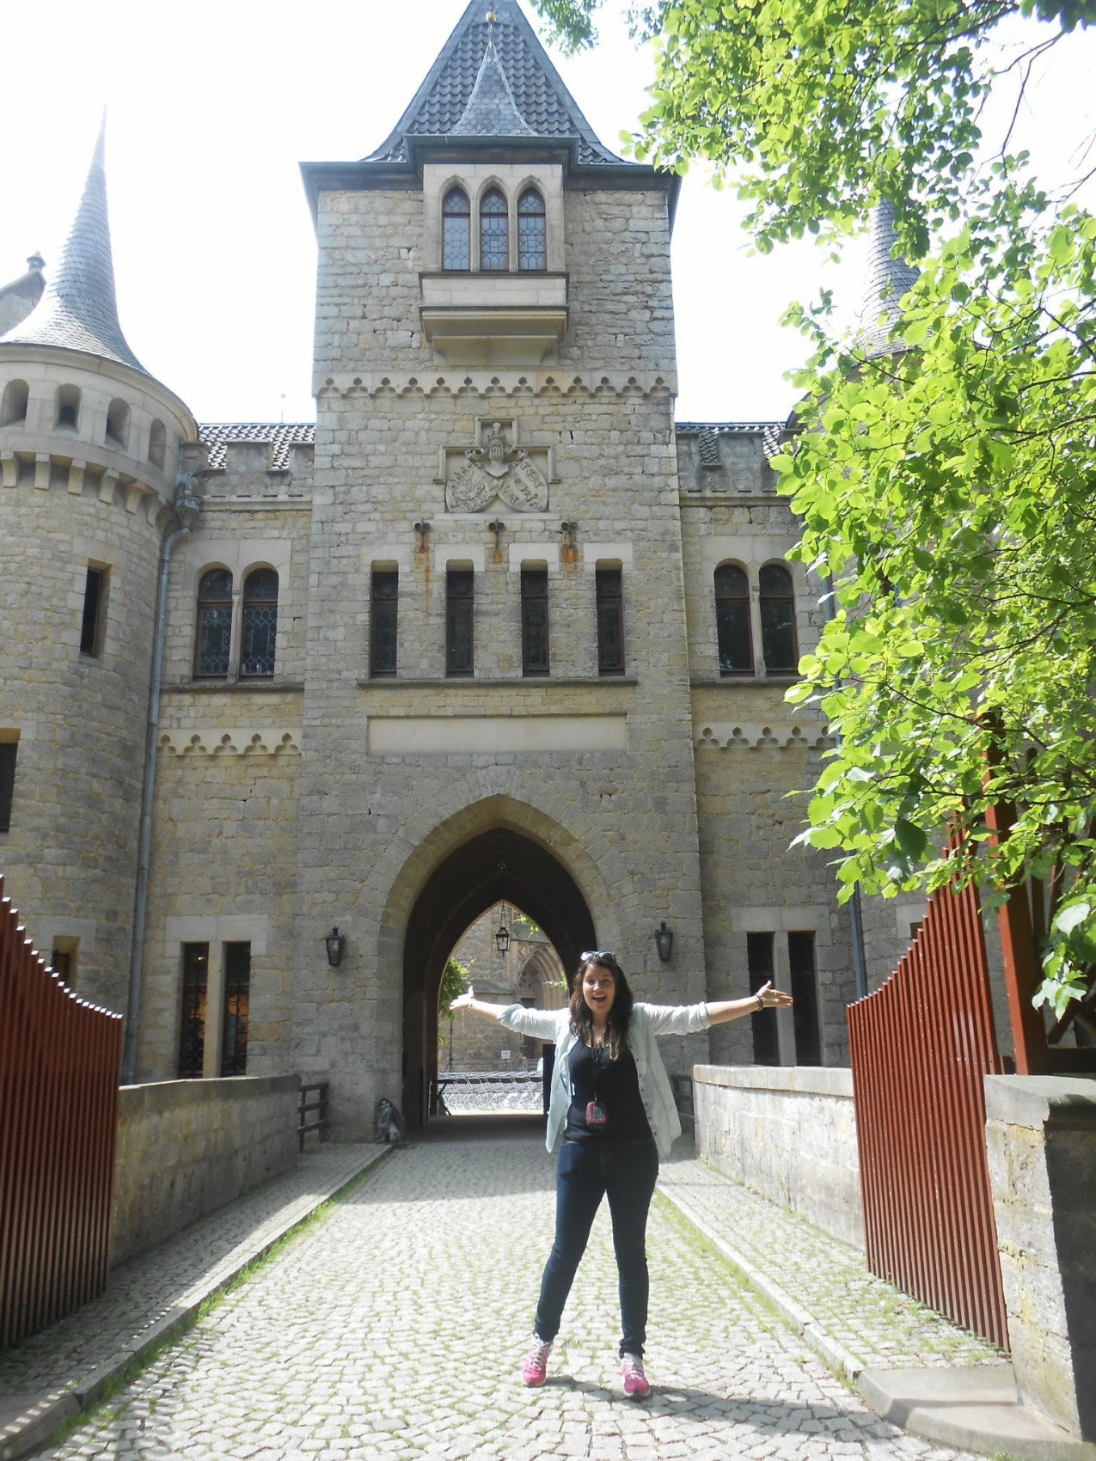


Slide 11
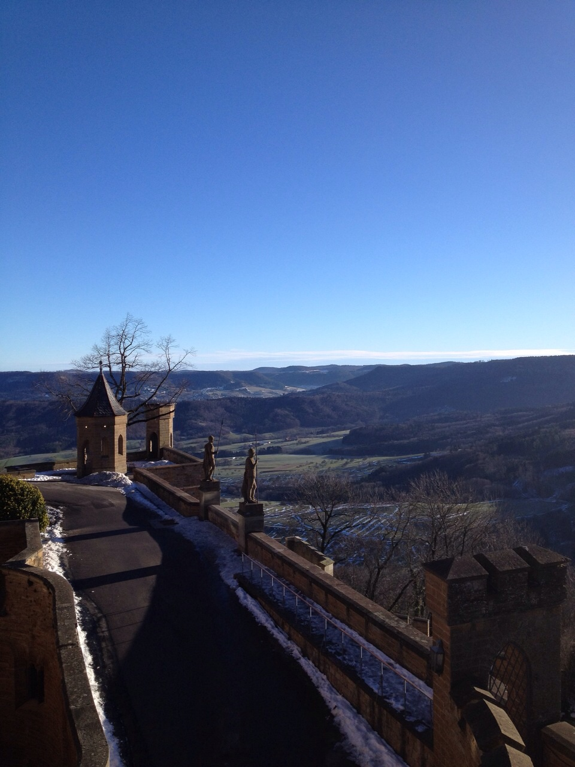
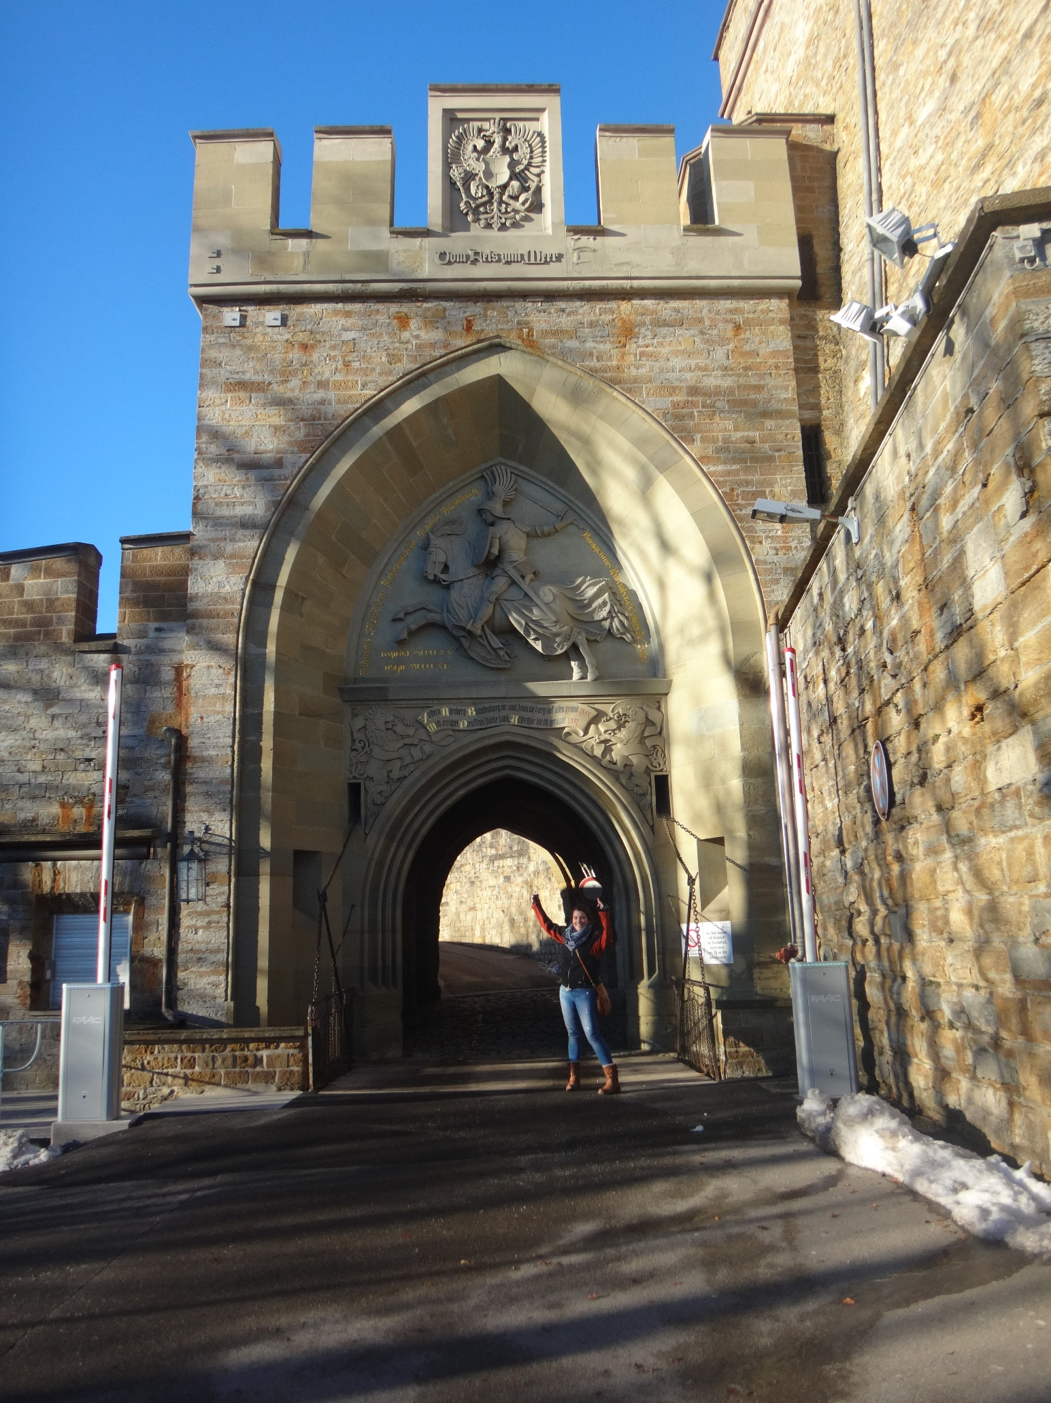

Slide 12
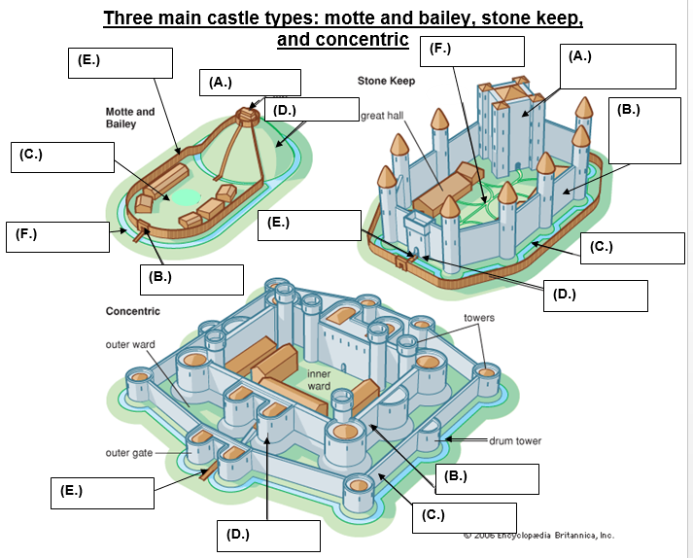

Slide 14
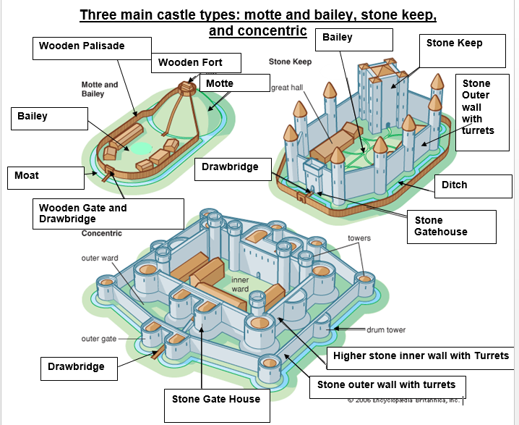

Slide 15

The castle was the first and foremost a fortress, designed to protect the interests of the lord or king who owned it. But the castle served other functions as well. It provide living quarters for the lord and his family, and their servants; barracks for the lord’s soldiers; homes for the craftspeople; an office from which to manage the lord’s estate; and a court to enforce law and order. In times of danger, the bailey courtyard also provided shelter for the villagers who lived nearby.

Slide 16

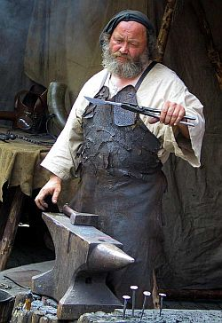
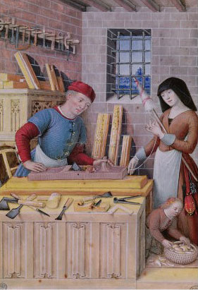
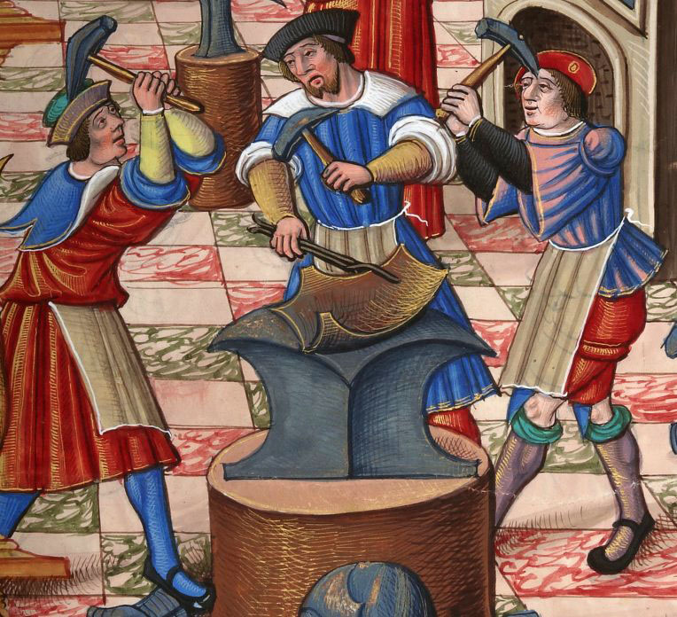
In many ways a great castle was very much like a small town. Blacksmiths, shoemakers, tailors, armourers, spinners, millers and others were there to fill the needs of the castle occupants.

Slide 17
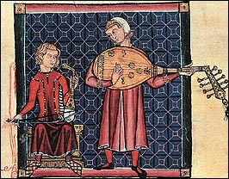
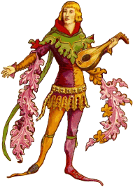
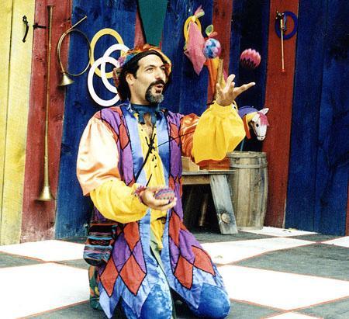
Often there were minstrels, troubadours (poet-musicians), jugglers, acrobats and others to entertain the lord, his family and his many guests.

Slide 18
Running a castle was a very big job. When the lord was away from the castle – at another of his castles, at war, on a crusade or seeing to some other business – the lady of the castle was in charge. The lord and lady had a large staff to help them. One of the most important staff members was the chief steward. Although a peasant, he was very powerful; he was an overseer of the household and was entrusted with the care and education of the lord’s children.

